Slide 1
Types of relationship

Slide 2
Types of Relationship in Database :-
Relationships define how entities relate to one another.
Types of relationship
One to One relationship
One to many relationship
many to one relationship
Many to many relationships

Slide 3
One to One relationship :-
One to One Relationship (1:1):
It is used to create a relationship between two tables in which a single row of the first table can only be related to one and only one records of a second table.
Similarly, the row of a second table can also be related to anyone row of the first table.

Slide 4
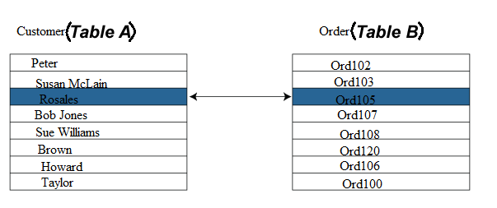
One to one relationship example :-

Slide 5
One to Many Relationship
One to Many Relationship: It is used to create a relationship between two tables. Any single rows of the first table can be related to one or more rows of the second tables, but the rows of second tables can only relate to the only row in the first table.
It is also known as a many to one relationship.

Slide 6
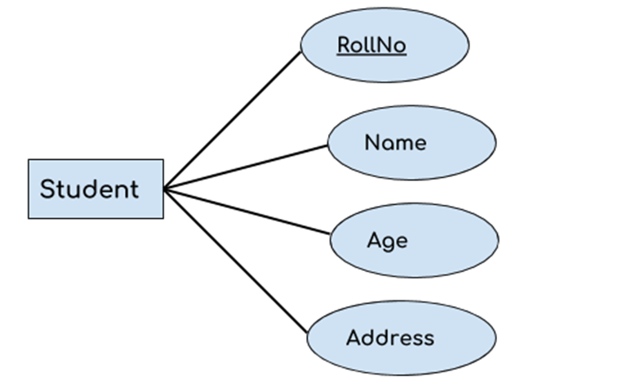
One to Many Relationship example :-

Slide 7
Many to Many Relationship:
Many to Many Relationship:
It is many to many relationships that create a relationship between two tables.
Each record of the first table can relate to any records (or no records) in the second table. Similarly, each record of the second table can also relate to more than one record of the first table.
It is also represented an N:N relationship.

Slide 8


Slide 9
Components of SQL
DDL(Data Definition Language) :-
Create, Alter, Drop, Truncate, Grant, Revoke
DML(Data Manipulation Language) :-
Insert, Update, Delete
DCL(Data Control Language) :-
Commit, Savepoint, Rollback, Grant/Revoke
DQL(Data Query Language) :-
SELECT

